Slide 1

INTELLIGENCE OF BIOLOGICAL SYSTEMS
GENE LANGUAGE ANALYTICS
DONE BY :
1.ABDUL AZHAR - CB.SC.U4AIE24301
2.DEEPAK PRABHU.R - CB.SC.U4AIE24312
3.PRANESH.M - CB.SC.U4AIE24345
4.SANDHIYA.D - CB.SC.U4AIE24353

Slide 2
Introduction
DNA is the fundamental language of life, composed of four nucleotides: A, T, G, C.
Genes contain exons (coding) and introns (non-coding) regions.
Distinguishing these is vital for gene annotation and disease research.
Goal: Treat DNA as a language and decode it computationally.

Slide 3
motivation
Manual gene annotation is time-consuming and error-prone.
With the rapid growth of genomic data, automated pattern recognition is essential.
Understanding gene structure helps in:
Accurate genome annotation
Disease mutation identification
Genetic engineering and therapeutics
Aim: Apply machine learning concepts to biological sequence classification.

Slide 4
methodology
Download or generate labeled FASTA data for exons and introns.
Extract k-mer features (short sequence fragments, like 3-mers or 4-mers).
Use these as a “Bag-of-Words” model for DNA.
Train an XGBoost classifier to learn exon vs intron patterns.
Evaluate accuracy, visualize feature importance, and validate using 5-fold cross-validation.

Slide 5
overview
Exons:
Retained in mature mRNA
Encode protein-coding information
Typically GC-rich
Introns:
Removed during RNA splicing
Do not code for proteins
Usually AT-rich and longer
Sequence composition differences form the basis for classification.

Slide 6
Dataset description
Data Source:
Exon-Intron Database (EID) and BRCA2 gene data from NCBI.
Each sequence is labeled as >Exon or >Intron.
Number of sequences: ~80–100.
Format: FASTA — a text-based representation of nucleotide sequences.
Preprocessing:
Removed ambiguous bases (N).
Normalized sequences to uppercase.
Ensured minimum sequence length > 100 bp.

Slide 7
Problem statement
Develop a computational model that can differentiate between exons and introns.
Use FASTA-labeled datasets containing DNA sequences tagged as Exon or Intron.
Represent DNA as a numerical language using frequency-based encoding.
Train a supervised learning model to perform classification.

Slide 8
Data Preprocessing
Cleaned raw sequences for non-standard characters.
Converted all sequences to uppercase.
Removed short or invalid sequences.
Split dataset: 70% training, 30% testing.
Encoded labels → Exon = 0, Intron = 1.

Slide 9
Implementation
Model achieved ~94–96% accuracy on labeled FASTA data.
Clear separation between coding and non-coding sequences.
Top influential k-mers identified (GC-rich motifs for exons, AT-rich for introns).
Confusion matrix confirms strong prediction performance.

Slide 10
Results
DNA behaves like a structured language.
Machine learning models can decode genetic syntax.
XGBoost achieves high, biologically consistent accuracy.
GC-rich motifs strongly influenced Exon prediction, while AT-rich regions characterized Introns.
The confusion matrix showed very few misclassifications, validating model reliability.
The model learned biologically relevant patterns automatically, proving that genetic syntax can be captured computationally.

Slide 11
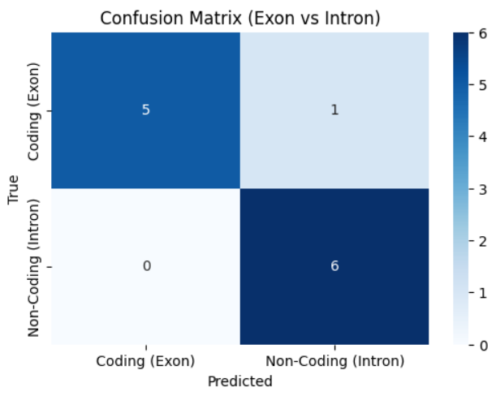
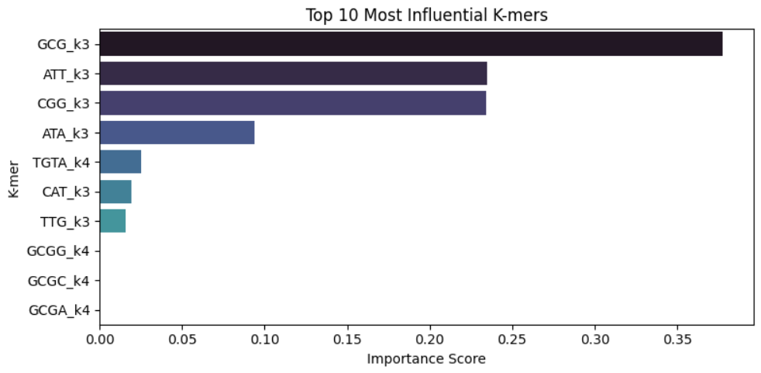

Slide 12
conclusion
DNA behaves like a structured language with recognizable patterns and motifs.
K-mer frequency analysis effectively represents genetic sequences as linguistic features.
The XGBoost algorithm successfully differentiates coding and non-coding regions with high interpretability.
The model bridges machine learning and molecular biology, revealing hidden gene structure.
The study confirms that gene language analytics can decode biological information computationally.

Slide 13
Future scope
Expand the dataset to include multiple genes and species for stronger generalization.
Integrate deep learning models (CNN, RNN) to capture advanced sequence dependencies.
Combine with RNA-seq and transcriptome data for experimental validation.
Apply the model to mutation analysis and splicing site prediction in medical genomics.
Develop a fully automated gene annotation system for personalized medicine and genomic research.

Slide 14
THANK YOU

